Slide 1
Database Project 2:
Air Passenger Arrival Database System
Group member:
Jordan Gho Jun Sheng (2200564)
Oh Jiang Yi (2200548)
Tan Jeng Siang Joel (2201062)
Yeo Chin Seng Samuel (2201066)
Yuan Yucheng (2203365)

Slide 2
Table of Content
Description of Application
Functionalities
Performance Analysis and System Limitations
Video demonstration
Yuan Yucheng

Slide 3
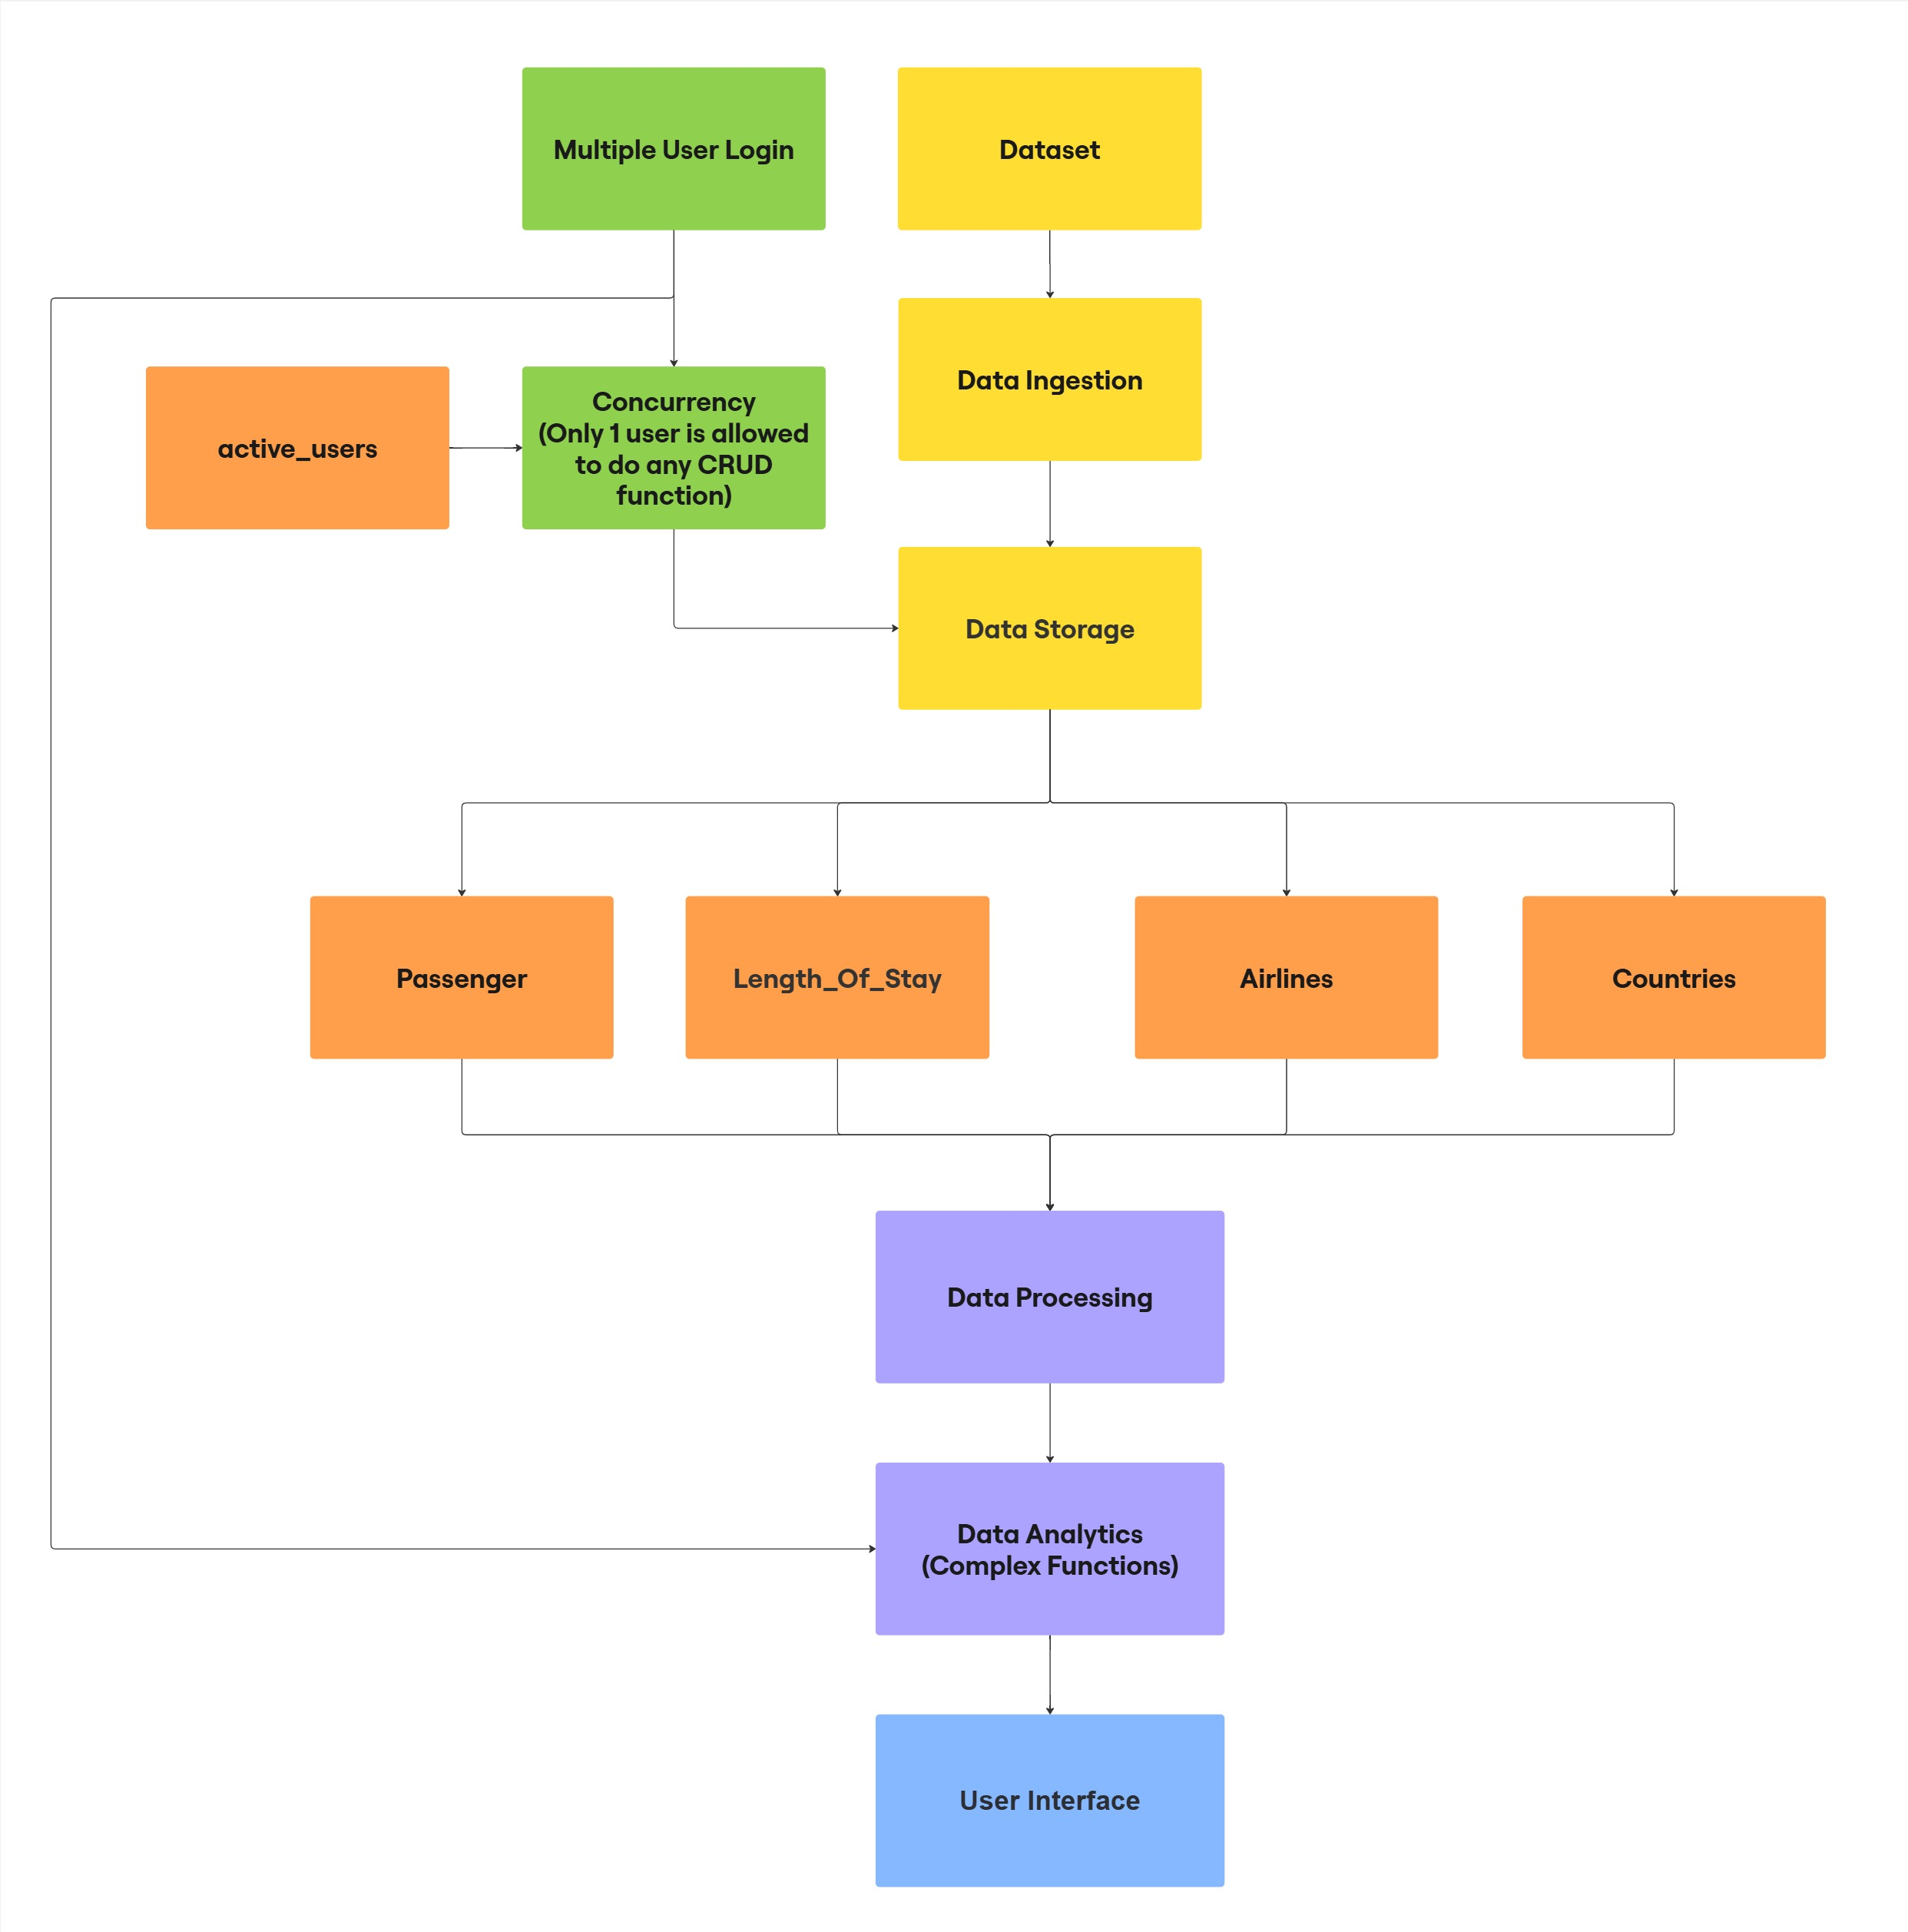
Application Description
Yuan Yucheng

Slide 4
Application Description (cont.)
Collections | Description
passenger | Stores essential details about visitors travelling to Singapore.
Countries | Store information about visitor numbers by country.
Airlines | Store information about visitors numbers by airline.
length_of_stay | Store information about how long visitors stay in Singapore.
active_users | Store information about who is using any of the CRUD function to lock the system.
Table 1: Collection-Description
Yuan Yucheng

Slide 5
Functionalities
Functionality | Description
Create Passenger by Name, Age, Gender, Length of Stay, Airline, Country | Allow system to add passenger arrival data to any of the tables
Read Passenger Arrival by Name, Age, Gender, Length of Stay, Airline, Country | Allow system to view amount of passenger depending on the tables
Update Passenger by Name, Age, Gender, Length of Stay, Airline, Country | Allow system to update passenger arrival data from any of the tables
Delete Passenger by Name, Age, Gender, Length of Stay, Airline, Country | Allow system to remove passenger arrival data from any of the tables
Table 2.1: CRUD Functions
Yeo Chin Seng Samuel

Slide 6
Functionalities (cont.)
Functionalities | Description
Analyse Airline Popularity | Compares passenger counts across airlines entering Singapore to determine the most popular carriers. Generates a visualisation of airline popularity based on incoming visitor data.
Analyse Tourism Duration | Categorising lengths into ranges and identify the most common duration. Provides insights for tailoring tourism strategies based on visit lengths.
Analyse Airline Trend | Analyses and identify relationships and trends between passenger country of origin and airlines, travel routes and airline preferences through comparative data analysis and charting.
Table 2.2: Complex Functions
Yeo Chin Seng Samuel

Slide 7
Functionalities (cont.)
Functionalities | Description
Searching using indexes | Primary index created on the “passenger id (pid)" field ASCENDING order ensures optimized search performance Unique constraint prevents duplicate PIDs Direct lookup using indexed PID field O(1) time complexity for PID searches
Multiple Users on one database | JWT-based authentication for secure user sessions Unique user identification using UUID Role-based access control implementation Global tracking of current users Time zone-aware session handling Active user monitoring in database
Table 2.3: Indexing and Concurrency Functions
Yeo Chin Seng Samuel

Slide 8
Functionalities (cont.)
Functionalities | Description
Concurrency control: Lock | Operation-specific locking (CREATE, READ, UPDATE, DELETE) Automatic timeout after 5 minutes Lock status monitoring User-specific lock ownership Real-time lock status updates Prevention of deadlocks through timeouts
Table 2.4: Locking Functions
Yeo Chin Seng Samuel

Slide 9
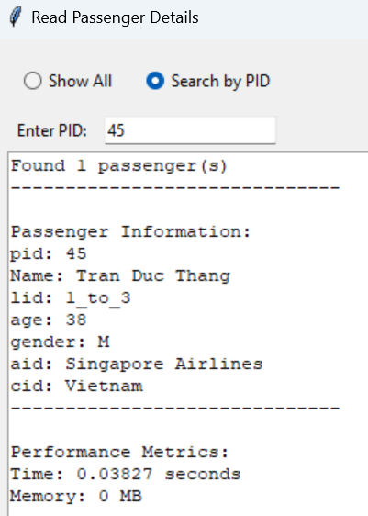
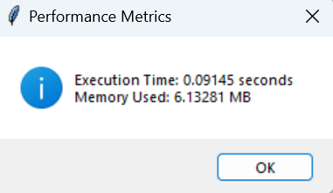
Performance Analysis
Fig 2: Performance Metrics for Complex Function
Fig 1: Performance Metrics for Read Function
Tan Jeng Siang Joel

Slide 10
System Limitations
No Caching implementation
Limited to South East Asia
Basic Analysis Capabilities
Basic Error messages without detailed troubleshooting
No automated backup system
Tan Jeng Siang Joel

Slide 11
Video Demonstration
Jordan Gho Jun Sheng & Oh Jiang Yi

Slide 12
Point of Contact: Oh Jiang Yi: 2200548@sit.singaporetech.edu.sg

